Slide 1

TASK:-10
TASK Details:- Inference Mapping
*Collect one reference article for anyone of the given problem.
*Create inference report for the article collected.
Q)Drone application in the revamping of process plants

Slide 2

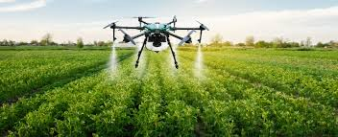
About Drones:-
Drones have revolutionized the processing of plants by enhancing efficiency, precession & data collection in agriculture.
Equipped with advanced sensors & imagine technology , drones play a critical role various stages of plants management, from planting to harvesting.
One primary application of drones is in crop monitoring.

Slide 3

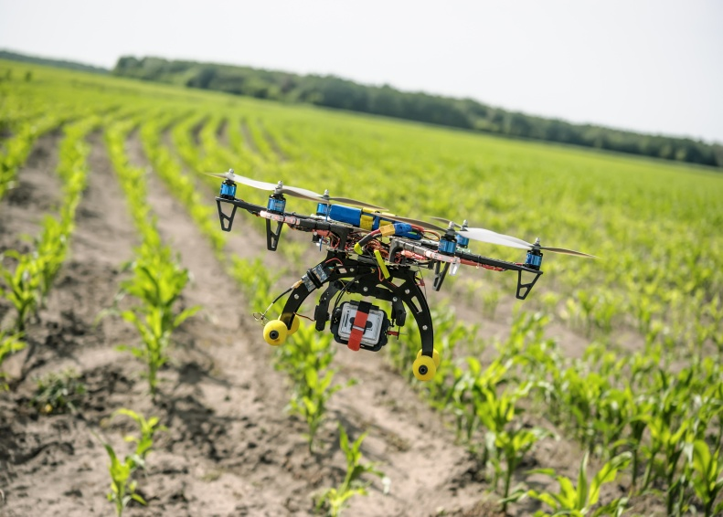
They cover large areas quickly, capturing high resolution images that allow farmers to access plant health, growth patterns & potential pest infestations. Multispectral & thermal imaging help identify stress in plants before visible symptoms appear.
Enabling timely interventions that can save crops and resources. By analyzing the aerial imaginary, farmers can optimize irrigation, fertilization & pesticide application, ensuring that resources are used efficiently. This targeted approach minimizes waste & reduces environmental impact, leading to move sustainable farming practices.

Slide 4

Some models are designed to shoot seedpods into the ground, allowing for rapid reforestation or crop planting in areas that are difficult to access. This method not only speeds up the planting process but also ensured a more uniform distribution of seeds. Moreover, drones can stream line the harvesting phase. They can access crop maturity & identify the best times for harvest, ensuring maximum yield quality. By integrating the drone technology with other agricultural innovations, farmers can enhance productivity and profitability.

Slide 5
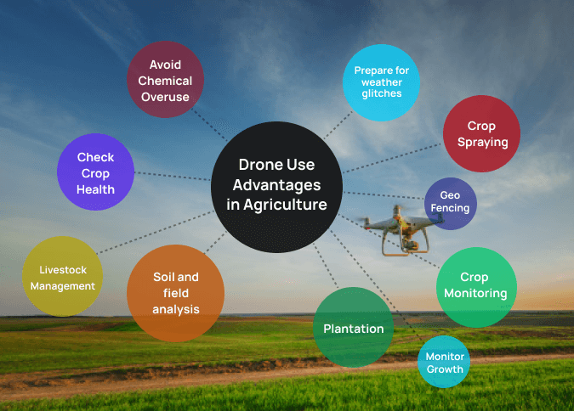
Advantages of Drones in Agriculture:-

Slide 6
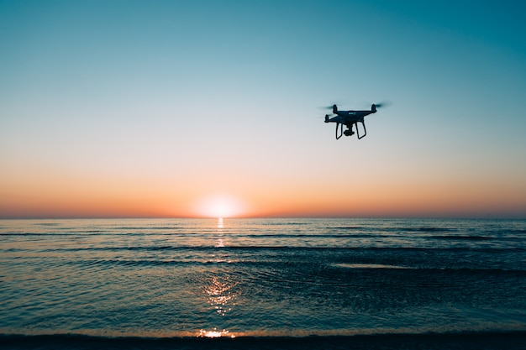
Crop Monitoring & Health Assessment:-
Drones equipped with multispectral cameras capture images that reveal plant health through various wavelengths of light. This technology allows farmers to monitor
chlorophyll levels, detect nutrient deficiencies, identify water stress & enabling proactive measures to maintain crop health.

Slide 7
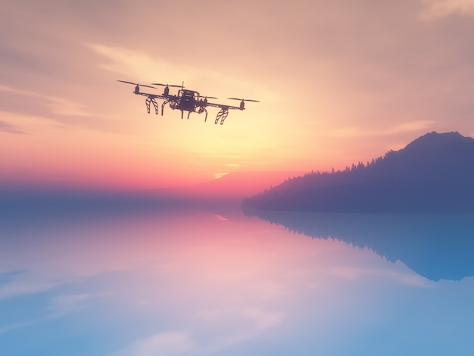
Precision Agriculture:-
By analyzing drone collected data, farmers can implement precision agriculture techniques. This involves applying fertilizers and pesticides only where needed, based on detailed mapping of field conditions. Such practices not only reduce input cause but also minimize environmental impact.

Slide 8


Soil Analysis:-
Drones can be used to create detailed maps of soil types & moisture levels, facilitating better planning for crop rotation & irrigation strategy. This data helps in understanding the specific needs of different areas within a farm, leading to more tailored & effective management practices.

Slide 9

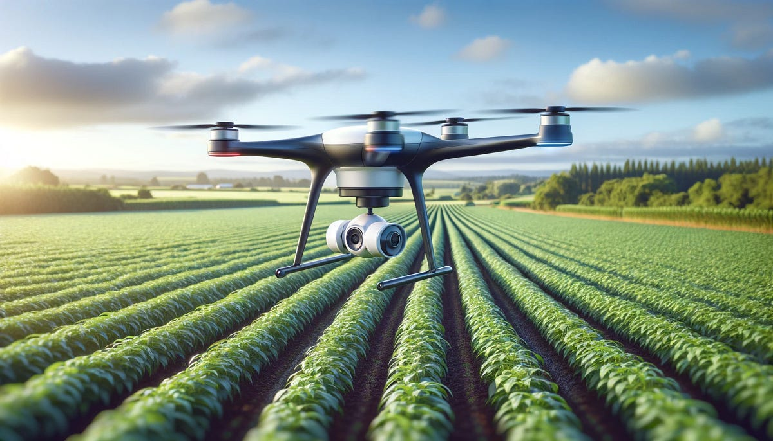
Pest & Disease Detection:-
The ability of drones to cover vast areas quickly makes them ideal for early pest & diseases detection. They can identify affected plants, allowing for targeted treatment rather than blanket applications, which helps preserve beneficial insects and improve overall ecosystem health.

Slide 10

Planting and Reforestation:-
Certain drones are designed specially for planting seeds in degraded areas. They can disperse seedpods containing nutrients and moisture retaining gels, enabling rapid reforestation efforts in hard to reach areas, which is crucial for biodiversity and climate resilience.

Slide 11

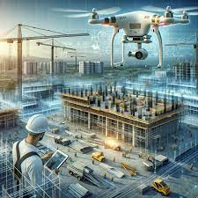

Cost Efficiency:-
Implementing drone technology can lead to significant cost savings for farmers. By increasing efficiency and reducing the need for manual labor and excessive inputs, drones help in improving the overall economic viability of farming operations.

Slide 12

Conclusion:-
Overall, drones are transforming agricultural practices by providing detailed insights & facilitating efficient management. Their ability to enhance productivity, sustainability & resource management positions them as vital tools for the future of agriculture. As technology continues to evolve, the potential applications of drones in plant processing & management will expand, further contributing to food security & environmental conservation. Drones have become indispensable tools in plant processing, providing critical data & facilitating efficient agricultural practices.

Slide 13


